Slide 1
Strong Key Derivation from Noisy Sources
Benjamin Fuller
Based on three works:
Computational Fuzzy Extractors [FullerMengReyzin13]
When are Fuzzy Extractors Possible? [FullerSmithReyzin14]
Key Derivation from Noisy Sources with More Errors than Entropy [CanettiFullerPanethSmithReyzin14]
December 12, 2014
Notes:
1
1

Slide 2
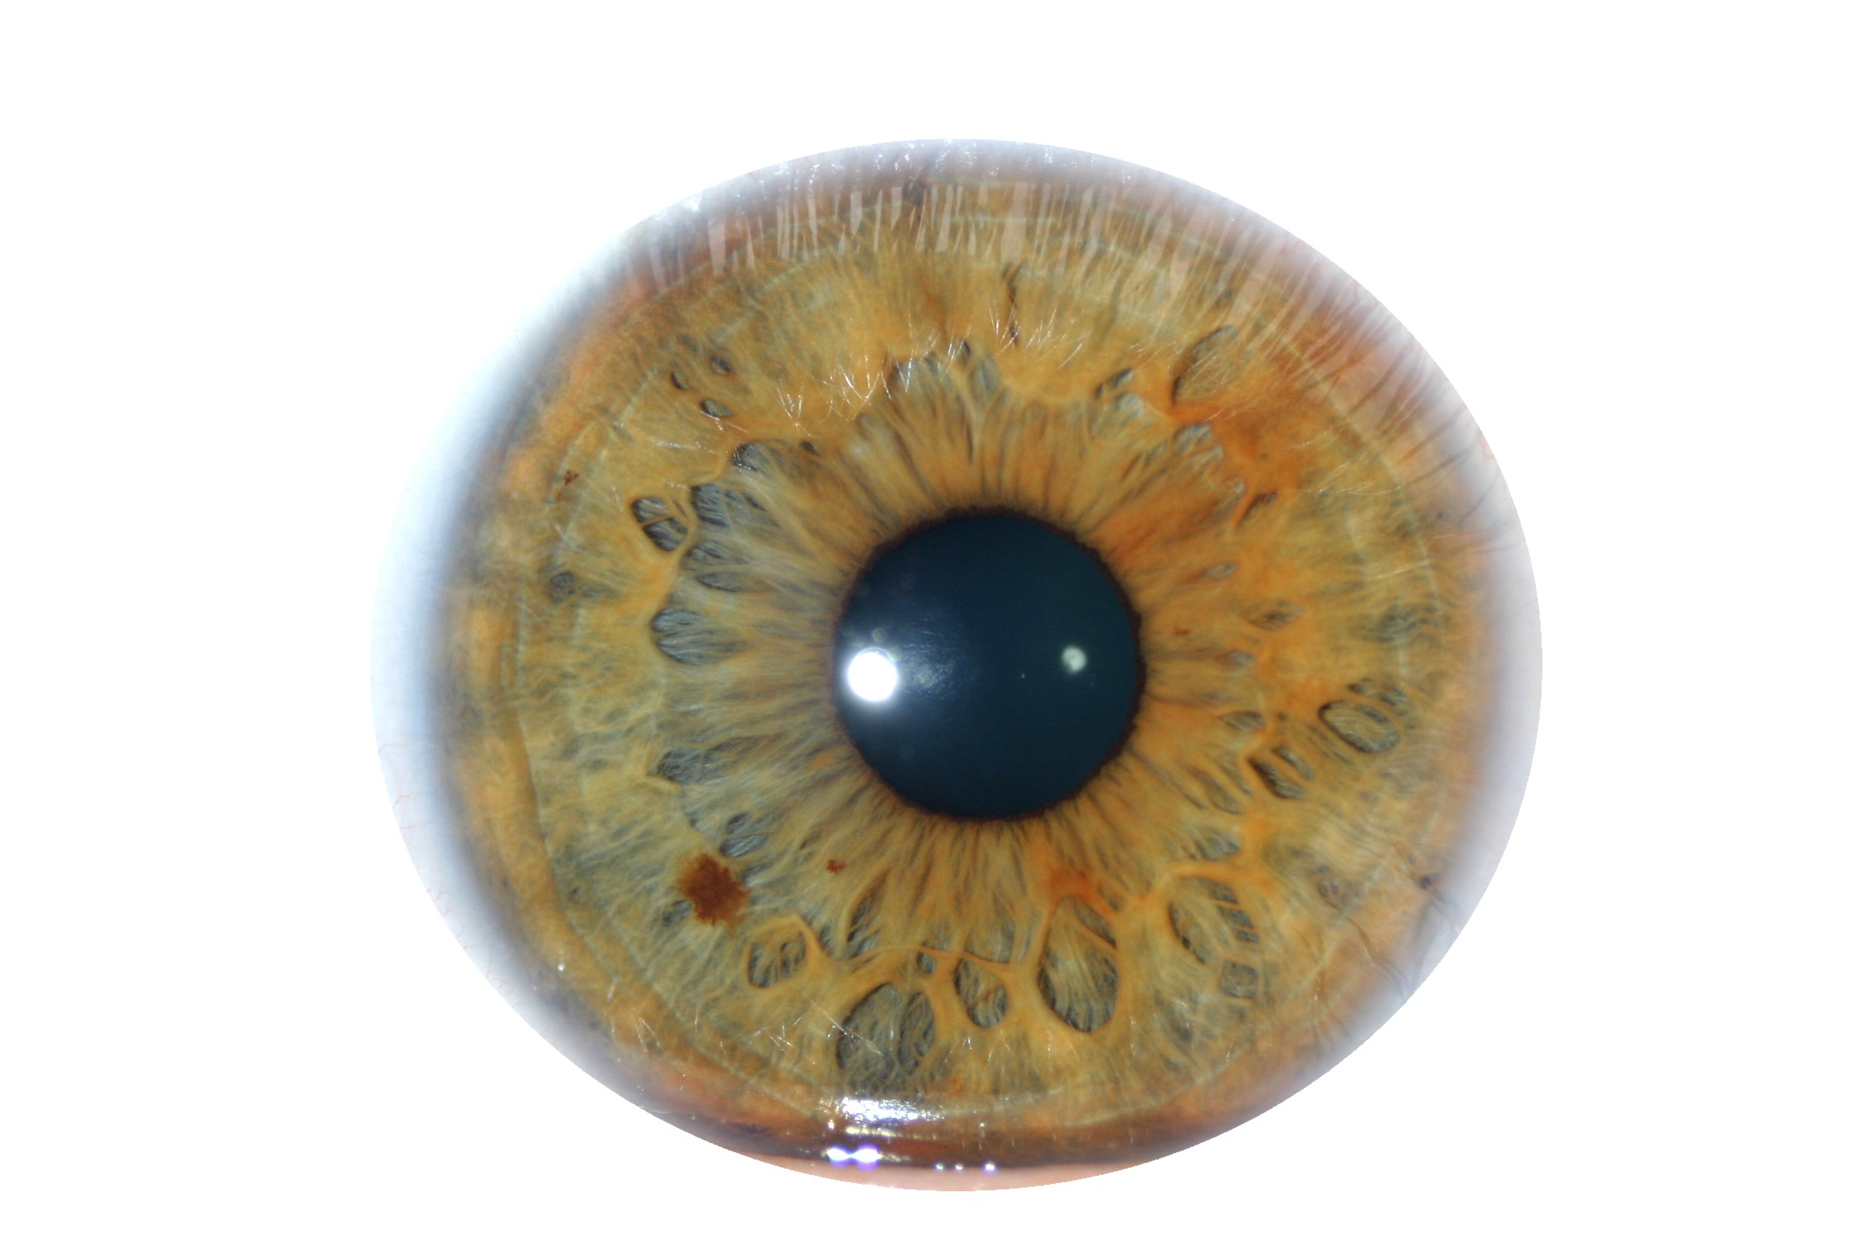
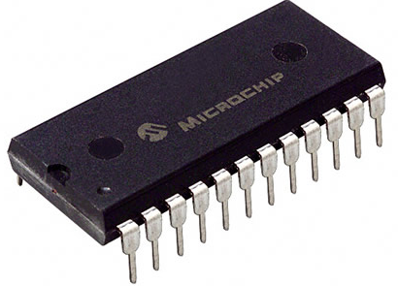
Key Derivation from Noisy Sources
Physically Unclonable Functions (PUFs)
Biometric Data
High-entropy sources are often noisy
Initial reading w₀ ≠ later reading reading w₁
Source w₀ = a₁,…, a_{k}, each symbol a_{i} over alphabet Z
Assume a bound on distance: d(w₀, w₁) ≤ t
d(w₀, w₁)=# of symbols in that differ
d(w₀, w₁)=4
w₀
A | B | C | A | D | B | E | F | A | A
A | G | C | A | B | B | E | F | C | B
w₁
Notes:
http://sigma.octopart.com/14152599/image/Microchip-TC14433EPG.jpg
http://www.drgaelriverz.com/images/Round_Eye.JPG

Slide 3
Key Derivation from Noisy Sources
Physically Unclonable Functions (PUFs)
Biometric Data
High-entropy sources are often noisy
Initial reading w₀ ≠ later reading reading w₁
Source w₀ = a₁,…, a_{k}, each symbol a_{i} over alphabet Z
Assume a bound on distance: d(w₀, w₁) ≤ t
Goal: derive a stable cryptographically strong output
Want w₀, w₁ to map to same output
The output should look uniform to the adversary
Goal of this talk: produce good outputs in scenarios we couldn’t handle before
Notes:
http://sigma.octopart.com/14152599/image/Microchip-TC14433EPG.jpg
http://www.drgaelriverz.com/images/Round_Eye.JPG

Slide 4
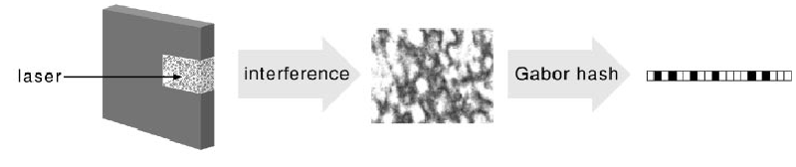
Physical Unclonable Functions (PUFs) [PappuRechtTaylorGershenfeld02]
Hardware that implements random function
Impossible to copy precisely
Large challenge/response space
On fixed challenge, responses close together
interference
Gabor Hash
Laser

Slide 5
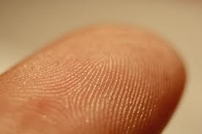
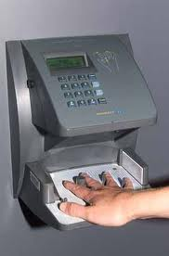
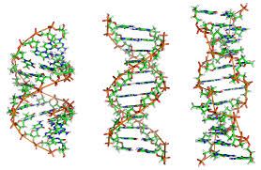
Biometrics
Measure unique physical phenomenon
Unique, collectable, permanent, universal
Repeated readings exhibit significant noise
Uniqueness/Noise vary widely
Human iris believed to be “best” [Daugman04], [PrabhakarPankantiJain03]

Slide 6


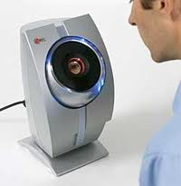
Two Physical Processes
w₀
Uncertainty
w₀ – create a new biometric or hardware device, take initial reading
w₁
Errors
w₁ – take new reading from a fixed biometric or hardware device
Two readings may not be subject to same noise. Often less error in original reading

Slide 7
Outline
Strong Authentication through Key Derivation
Key Derivation from Noisy Sources
Limitations of Traditional Approaches/Lessons
New Constructions

Slide 8

Key Derivation from Noisy Sources
Interactive Protocols [Wyner75] … [BennettBrassardRobert85,88] …lots of work…
Problem: User must store initial reading w₀ at server
w₀
w₁
Want approach where w₀ is not stored!
Parties agree on cryptographic key

Slide 9
Fuzzy Extractors: Functionality [JuelsWattenberg99], …, [DodisOstrovskyReyzinSmith04] …
Enrollment algorithm Gen: Take a measurement w₀ from the source. Use it to “lock up” random r in a nonsecret value p.
Subsequent algorithm Rep: give same output if d(w₀, w₁) < t
Security: r looks uniform even given p, when the source is good enough
Traditionally, security def. is information theoretic
Gen
r
w₀
Rep
p
r
< t
w₁

Slide 10
Fuzzy Extractors: Goals
Goal 1: handle as many sources as possible (typically, any source in which w₀ is 2^{k}-hard to guess)
Goal 2: handle as much error as possible (typically, any w₁ within distance t)
Most previous approaches are analyzed in terms of t and k
Traditional approaches do not support sources with t > k (many practical sources)
Gen
r
entropy k
w₀
Rep
p
r
< t
w₁

Slide 11
Contribution
Three lessons on how to construct fuzzy extractors for practical sources
Eliminate Secure Sketches [FMR13]
Exploit Distributional Structure [FRS14]
Define Objects Computational [FMR13]
Constructions of fuzzy extractors for large classes of distributions where t > k [CFPRS14]
Reusable fuzzy extractor for arbitrary correlation between repeated readings [CFPRS14]

Slide 12
Fuzzy Extractors: Typical Construction
- derive r using a randomness extractor
(converts high-entropy sources to uniform, e.g., via universal hashing [CarterWegman77])
- correct errors using a secure sketch
[DodisOstrovskyReyzinSmith08]
(gives recovery of the original from a noisy signal)
Gen
r
entropy k
w₀
Ext
Rep
p
r
< t
Ext
w₁

Slide 13
Fuzzy Extractors: Typical Construction
- derive r using a randomness extractor
(converts high-entropy sources to uniform, e.g., via universal hashing [CarterWegman77])
- correct errors using a secure sketch
[DodisOstrovskyReyzinSmith08]
(gives recovery of the original from a noisy signal)
Gen
r
entropy k
w₀
Ext
Rep
p
r
w₀
< t
Sketch
Ext
Rec
w₁

Slide 14
Secure Sketches
Generate
r
w₀
Ext
Reproduce
r
p
< t
Sketch
Rec
Ext
w₁
Code Offset Sketch
[JuelsWattenberg99]
c
p =c ⊕ w₀
C – Error correcting code correcting t errors
Notes:
I’ll start by describing the sketch algorithm.
<click, click>
The sketch I am going to describe is called the “code-offset sketch” in the literature. Assume we have an error correcting code that can correct dmax errors.
<click>
We will start by selecting a random codeword. So we select a random value x and encode x using the error correcting code. We will use this ec value as a mask for our value w_0.
<click>
Our public value p will be the exclusive or of the value ec and our original reading. Remember, we want two properties from p: it should allow recovery from a close value w_1 and it shouldn’t give much information about w_0.

Slide 15
Secure Sketches
Generate
r
w₀
Ext
Reproduce
r
p
< t
Sketch
Rec
Ext
w₁
Code Offset Sketch
[JuelsWattenberg99]
c
c’=Decode(c*)
If decoding succeeds, w₀ = c’ ⊕ p.
p ⊕ w₁ = c*
p =c ⊕ w₀
C – Error correcting code correcting t errors
Notes:
I’ll now show have the first property is fulfilled.
<click>
This is done in the Recovery function.
<click>
So the recovery function has just the public value p and the new reading w_1.
<click>
It adds these two values together.
<click>
We then run the decoding procedure of the error correcting code on this value p\oplus w_1. This gives us a value ec’.
<click>
If w_0 and w_1 are within the decoding radius for the error correcting code then ec’ = ec. This means we can recover the value w_0 from a close w_1.

Slide 16
Secure Sketches
Generate
r
w₀
Ext
Reproduce
r
p
> t
Sketch
Rec
Ext
w’₁
Code Offset Sketch
[JuelsWattenberg99]
p has info about w₀. How much does it hurt security?
p ⊕ w₁ = c*
p =c ⊕ w₀
C – Error correcting code correcting t errors
p ⊕ w’₁
Notes:
We will now work on the second property. We need the value p not to give much information about w_0.
<click>
Consider the case where we collect a reading from a different source, say w_0’.
<click, click>
This means that p \oplus w_0’ will not be close to the original codeword and decoding will give an unrelated value.
<click> Formally, we can say that W_0 retains high entropy even conditioned on the public value p. This is the main novel contribution of a secure sketch (otherwise we could just provide error correcting information.
<click>
Recall the starting entropy was k. We will call k-k’ the entropy loss of a secure sketch. This value is important as it determines the strength of our key.
<click>
In particular, the extractor must be able to produce a good key with only k’ bits of entropy.

Slide 17
Outline
Strong Authentication through Key Derivation
Key Derivation from Noisy Sources
Limitations of Traditional Approaches/Lessons
New Constructions

Slide 18
Problem with Secure Sketches
p must store enough information to recover w₀
How much information is that?
Gen
r
entropy k
w₀
Ext
Rep
p
r
w₀
< t
Sketch
Ext
Rec
w₁

Slide 19
Problem with Secure Sketches
p must store enough information to recover w₀
How much information is that?
If all Rep knows about source is entropy, w₀ can be anywhere within distance t, so log |B_{t} | > t bits
Current approaches provide no security if t > k
stores t bits about w₀
has k < t bits of entropy
Rep
r
w₀
p
r
B_{t}
w₀
< t
Ext
Rec
w₁

Slide 20
Problem with Secure Sketches
Fuzzy extractors and secure sketches have upper bounds on key length based on error tolerance
Secure sketches subject to stronger bounds
Thm [FMR13]: Secure sketches with computational security limited:
Can build sketches with info-theoretic security from sketches that provide computational security
stores t bits about w₀
has k < t bits of entropy
Rep
r
w₀
p
r
B_{t}
w₀
< t
Ext
Rec
w₁

Slide 21
Lessons
Stop using secure sketches
Subject to strong bounds
Bounds apply with computational security

Slide 22
Is it possible to handle “more errors than entropy” (t > k)?
This distribution has 2^{k} points
Why might we hope to extract from this distribution?
Points are far apart
No need to deconflict original reading
Support of w₀
w₁
Notes:
ADS: Bullet structure too simple here: these items don’t all belong in one list

Slide 23
Is it possible to handle “more errors than entropy” (t > k)?
Support of w₀
Support of v₀
r
Since t > k there is a distribution v₀ where all points lie in a single ball
Left and right have same number of points and error tolerance
Notes:
ADS: Bullet structure too simple here: these items don’t all belong in one list

Slide 24
Is it possible to handle “more errors than entropy” (t > k)?
Support of w₀
Support of v₀
t
?
r
r
Rep
t
r
r
w₁
Rep
v₁
r
The likelihood of adversary picking a point w₁ close enough to recover r is low
For any construction adversary learns r by running with v₁
Recall: adversary can run Rep on any point
Notes:
ADS: Bullet structure too simple here: these items don’t all belong in one list

Slide 25
Is it possible to handle “more errors than entropy” (t > k)?
To distinguish between w₀ and v₀ must consider more than just t and k
Support of w₀
Support of v₀
t
?
r
Rep
t
r
r
w₁
Rep
v₁
r
The likelihood of adversary picking a point w₁ close enough to recover r is low
For any construction adversary learns r by running with v₁
Key derivation may be possible for w₀, impossible for v₀

Slide 26
Lessons
Stop using secure sketches
Exploit structure of source beyond entropy
Need to understand what structure is helpful

Slide 27
Understand the structure of source
Minimum necessary condition for fuzzy extraction: weight inside any B_{t} must be small
Let H_{fuzz}(W₀) = log (1/max wt(B_{t}))
Big H_{fuzz}(W₀) is necessary
Q: Is big H_{fuzz}(W₀) sufficient for fuzzy extractors?
t
r
w₁
Rep

Slide 28
Is big H_{fuzz}(W₀) sufficient?
Thm [FRS]: Yes, if algorithms know exact distribution of W₀
Imprudent to assume construction and adversary have same view of W₀
Should assume adversary knows more about W₀
Deal with adversary knowledge by providing security for family V of W₀, security should hold for whole family
Thm [FRS]: No if W₀ is only known to come from a family V
A3: Yes if security is computational (using obfuscation) [Bitansky Canetti Kalai Paneth 14]
A4: No if security is information-theoretic
A5: No if you try to build (computational) secure sketch
Will show negative result for secure sketches (negative result for fuzzy extractors more complicated)

Slide 29
Thm [FRS]: No if W₀ comes from a family V
Describe a family of distributions V
For any fuzzy extractor Gen, Rep for most W₀ in V, few w* in W₀ could produce p
Implies W₀ has little entropy conditioned on p
Rep
w₀
p
B_{t}
w₀
< t
Rec
w₁

Slide 30
Now we’ll consider family V, Goal: for most W in V, can’t include many augmented fixed points
Adversary specifies V
Goal: build Sketch, Rec maximizing H(W | p), for all W in V
First consider one dist. W
For w₀, Rec(w₀, p) =w₀
For nearby w₁, Rec(w₁, p) = w₀
Call augmented fixed point
To maximize H(W|p) make as many points of W augmented fixed points
Augmented fixed points at least distance t apart (exponentially small fraction of space)
W
w₀ = Rec(w₀, p)
w₁

Slide 31
Adversary specifies V
Goal: build Sketch, Rec maximizing H(W | p), for all W in V
Sketch must create augmented fixed points based only on w₀
Build family with many possible distributions for each w₀
Sketch can’t tell W from w₀
W
w₀

Slide 32
Adversary specifies V
Goal: build Sketch, Rec maximizing H(W | p), for all W in V
Sketch must create augmented fixed points based only on w₀
Build family with many possible distributions for each w₀
Sketch can’t tell W from w₀
W
w₀

Slide 33
Adversary specifies V
Goal: build Sketch, Rec maximizing H(W | p), for all W in V
Sketch must create augmented fixed points based only on w₀
Build family with many possible distributions for each w₀
Sketch can’t tell W from w₀
W
w₀

Slide 34
Adversary specifies V
Goal: build Sketch, Rec maximizing H(W | p), for all W in V
Sketch must create augmented fixed points based only on w₀
Build family with many possible distributions for each w₀
Sketch can’t tell W from w₀
Forced to include augmented fixed points from all distributions with w₀
Adversary knows color of w₀
Viable points set by Gen
w₀

Slide 35
Adversary specifies V
Goal: build Sketch, Rec maximizing H(W | p), for all W in V
Sketch must create augmented fixed points based only on w₀
Build family with many possible distributions for each w₀
Sketch can’t tell W from w₀
Forced to include augmented fixed points from all distributions with w₀
Adversary knows color of w₀
Viable points set by Gen
Maybe this was a bad choice of viable points?
w₀
Adversary’s search space

Slide 36
Adversary specifies V
Goal: build Sketch, Rec maximizing H(W | p), for all W in V
Sketch must create augmented fixed points based only on w₀
Build family with many possible distributions for each w₀
Sketch can’t tell W from w₀
Forced to include augmented fixed points from all distributions with w₀
Adversary knows color of w₀
Alternative Points
w₀

Slide 37
Thm: Sketch, Rec can include at most 4 augmented fixed points from members of V on average
Adversary specifies V
Goal: build Sketch, Rec maximizing H(W | p), for all W in V
Sketch must create augmented fixed points based only on w₀
Build family with many possible distributions for each w₀
Sketch can’t tell W from w₀
Forced to include augmented fixed points from all distributions with w₀
Adversary knows color of w₀
Alternative Points
w₀
Adversary’s search space

Slide 38
Is big H_{fuzz}(W₀) sufficient?
Thm [FRS]: Yes, if algorithms know exact distribution of W₀
Imprudent to assume construction and adversary have same view of W₀
Deal with adversary knowledge by providing security for family V of W₀, security should hold for whole family
Thm [FRS]: No if adversary knows more about W₀ than fuzzy extractor creator
A3: Yes if security is computational (using obfuscation) [Bitansky Canetti Kalai Paneth 14]
A4: No if security is information-theoretic
A5: No if you try to build (computational) secure sketch
Fuzzy extractors defined information-theoretically (used info-theory tools),
No compelling need for info-theory security

Slide 39
Lessons
Stop using secure sketches
Exploit structure of source beyond entropy
Define objects computationally

Slide 40
Outline
Strong Authentication through Key Derivation
Key Derivation from Noisy Sources
Lessons
Stop using secure sketches
Exploit structure of source beyond entropy
Define objects computationally
New Constructions

Slide 41

Idea [CFPRS14]: “encrypt” r using parts of w₀
Gen: - get random combinations of symbols in w₀
r
- “lock” r using these combinations
r
w₀ = a₁ a₂ a₃ a₄ a₅ a₆ a₇ a₈ a₉
Gen
p
r
r
r
r
r
r
r
r
r
r
r
r
a₁ a₉ a₂
a₃ a₉ a₅
a₃ a₄ a₅
a₇ a₅ a₆
a₂ a₈ a₇
a₃ a₅ a₂

Slide 42
Idea [CFPRS14]: “encrypt” r using parts of w₀
Gen: - get random combinations of symbols in w₀
r
- “lock” r using these combinations
r
w₀ = a₁ a₂ a₃ a₄ a₅ a₆ a₇ a₈ a₉
Gen
p
r
r
r
r
r
r
r
r
r
r
r
r
a₁ a₉ a₂
a₃ a₉ a₅
a₃ a₄ a₅
a₇ a₅ a₆
a₂ a₈ a₇
a₃ a₅ a₂

Slide 43
Idea [CFPRS14]: “encrypt” r using parts of w₀
Gen: - get random combinations of symbols in w₀
r
- “lock” r using these combinations
r
w₀ = a₁ a₂ a₃ a₄ a₅ a₆ a₇ a₈ a₉
Gen
p
r
r
r
r
r
r
r
r
r
r
r
r
a₁ a₉ a₂
a₃ a₉ a₅
a₃ a₄ a₅
a₇ a₅ a₆
a₂ a₈ a₇
a₃ a₅ a₂

Slide 44
Idea [CFPRS14]: “encrypt” r using parts of w₀
Gen: - get random combinations of symbols in w₀
r
- “lock” r using these combinations
- = locks + positions of symbols needed to unlock
p
r
w₀ = a₁ a₂ a₃ a₄ a₅ a₆ a₇ a₈ a₉
Gen
p
r
r
r
r
r
r
a₁ a₉ a₂
a₃ a₉ a₅
a₃ a₄ a₅
a₇ a₅ a₆
a₂ a₈ a₇
a₃ a₅ a₂

Slide 45
Idea [CFPRS14]: “encrypt” r using parts of w₀
Gen: - get random combinations of symbols in w₀
r
- “lock” r using these combinations
- = locks + positions of symbols needed to unlock
p
r
w₀ = a₁ a₂ a₃ a₄ a₅ a₆ a₇ a₈ a₉
Gen
p
r
r
r
r
r
r
a₁ a₉ a₂
a₃ a₉ a₅
a₃ a₄ a₅
a₇ a₅ a₆
a₂ a₈ a₇
a₃ a₅ a₂

Slide 46
Idea [CFPRS14]: “encrypt” r using parts of w₀
Gen: - get random combinations of symbols in w₀
r
- “lock” r using these combinations
- = locks + positions of symbols needed to unlock
p
p
r
r
r
r
r
r
a₁ a₉ a₂
a₃ a₉ a₅
a₃ a₄ a₅
a₇ a₅ a₆
a₂ a₈ a₇
a₃ a₅ a₂

Slide 47
Idea [CFPRS14]: “encrypt” r using parts of w₀
Gen: - get random combinations of symbols in w₀
r
- “lock” r using these combinations
- = locks + positions of symbols needed to unlock
p
Rep:
w₁ = a₁ a₂ a₃ a₄ a₅ a₆ a₇ a₈ a₉
r
Rep
p
r
r
r
r
r
r
a₁ a₉ a₂
a₃ a₉ a₅
a₃ a₄ a₅
a₇ a₅ a₆
a₂ a₈ a₇
a₃ a₅ a₂

Slide 48
Idea [CFPRS14]: “encrypt” r using parts of w₀
Gen: - get random combinations of symbols in w₀
r
- “lock” r using these combinations
- = locks + positions of symbols needed to unlock
p
Rep:
w₁ = a₁ a₂ a₃ a₄ a₅ a₆ a₇ a₈ a₉
r
Rep
p
r
r
r
r
r
r
a₁ a₉ a₂
a₃ a₉ a₅
a₃ a₄ a₅
a₇ a₅ a₆
a₂ a₈ a₇
a₃ a₅ a₂

Slide 49
Idea [CFPRS14]: “encrypt” r using parts of w₀
Gen: - get random combinations of symbols in w₀
r
- “lock” r using these combinations
- = locks + positions of symbols needed to unlock
p
Rep: Use the symbols of w₁ to open at least one lock
w₁ = a₁ a₂ a₃ a₄ a₅ a₆ a₇ a₈ a₉
r
Rep
p
r
r
r
r
r
r
a₁ a₉ a₂
a₃ a₉ a₅
a₃ a₄ a₅
a₇ a₅ a₆
a₂ a₈ a₇
a₃ a₅ a₂

Slide 50
Idea [CFPRS14]: “encrypt” r using parts of w₀
Gen: - get random combinations of symbols in w₀
r
- “lock” r using these combinations
- = locks + positions of symbols needed to unlock
p
Rep: Use the symbols of w₁ to open at least one lock
w₁ = a₁ a₂ a₃ a₄ a₅ a₆ a₇ a₈ a₉
r
Rep
p
r
r
r
r
r
r
r
a₁ a₉ a₂
a₃ a₉ a₅
a₃ a₄ a₅
a₇ a₅ a₆
a₂ a₈ a₇
a₃ a₅ a₂

Slide 51
Idea [CFPRS14]: “encrypt” r using parts of w₀
Gen: - get random combinations of symbols in w₀
r
- “lock” r using these combinations
- = locks + positions of symbols needed to unlock
p
Rep: Use the symbols of w₁ to open at least one lock
Error-tolerance: one combination must unlock with high probability
Security: each combination must have enough entropy
(sampling of symbols must preserve sufficient entropy)
r
r
r
r
r
r
r
a₁ a₉ a₂
a₃ a₉ a₅
a₃ a₄ a₅
a₇ a₅ a₆
a₂ a₈ a₇
a₃ a₅ a₂

Slide 52
How to implement locks?
A lock is the following program:
If input = a₁ a₉ a₂, output r
Else output ⊥
One implementation (R.O. model): lock = r ⊕ H(a₁ a₉ a₂)
r
a₁ a₉ a₂
Ideally: Obfuscate this program
Obfuscation: preserve functionality, hide the program
Obfuscating this specific program called “digital locker”
Notes:
ADS: Say RO construction first? Then say point obfuscation?

Slide 53
Digital Lockers
r
Digital Locker is obfuscation of
If input = a₁ a₉ a₂, output r
Else output ⊥
Equivalent to encryption of r that is secure even multiple times with correlated, weak keys [CanettiKalaiVariaWichs10]
Digital lockers are practical (R.O. or DL-based) [CanettiDakdouk08], [BitanskyCanetti10]
Hides r if input can’t be exhaustively searched (superlogarithmic entropy)
a₁ a₉ a₂

Slide 54
Digital Lockers
r
Digital Locker is obfuscation of
If input = a₁ a₉ a₂, output r
Else output ⊥
Equivalent to encryption of r that is secure even multiple times with correlated and weak keys [CanettiKalaiVariaWichs10]
Digital lockers are practical (R.O. or DL-based) [CanettiDakdouk08], [BitanskyCanetti10]
Hides r if input can’t be exhaustively searched (superlogarithmic entropy)
a₁ a₉ a₂
Q: if you are going to use obfuscation, why bother? Why not just obfuscate the following program for p
If distance between w₀ and the input is less than t, output r
Else output ⊥
A: you can do that [BitanskyCanettiKalaiPaneth14], except it’s very impractical + has a very strong assumption

Slide 55
How good is this construction?
Handles sources with t > k
For correctness: t < constant fraction of symbols
r
r
r
r
r
r
a₁ a₉ a₂
a₃ a₉ a₅
a₃ a₄ a₅
a₇ a₅ a₆
a₂ a₈ a₇
a₃ a₅ a₂

Slide 56
How good is this construction?
Handles sources with t > k
For correctness: t < constant fraction of symbols
Construction 2:
Supports t= constant fraction but only for really large alphabets
Construction 3:
Similar parameters but info-theoretic security
Why did I tell you about computation constructional?
r
r
r
r
r
r
a₁ a₉ a₂
a₃ a₉ a₅
a₃ a₄ a₅
a₇ a₅ a₆
a₂ a₈ a₇
a₃ a₅ a₂
Notes:
ADS: too much text (break it up somehow?)

Slide 57
How good is this construction?
It is reusable!
Same source can be enrolled multiple times with multiple independent services
r
w₀
Gen
p
Secret even given
p, p', p'', r, r''
r'
w₀'
Gen
p'
r''
w₀''
Gen
p''

Slide 58
How good is this construction?
It is reusable!
Same source can be enrolled multiple times with multiple independent services
Follows from composability of obfuscation
In the past: difficult to achieve, because typically new enrollments leak fresh information
Only previous construction [Boyen2004]: all reading must differ by fixed constants (unrealistic)
Our construction: each reading individually must satisfy our conditions

Slide 59
Conclusion
Lessons:
Don’t use secure sketches (i.e., full error correction)
Exploit structure in source
Provide computational security
It is possible to cover sources with more errors than entropy!
Also get reusability!
t
Questions?

Slide 60

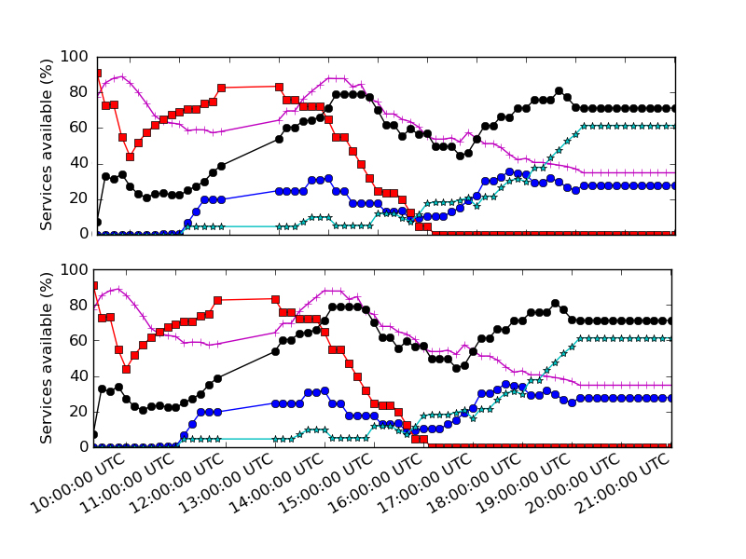






Establishing Trust Today
Password or Feature-space representation
Crypto Hashes
Stored Templates
[RathaConnelleBolle2001]
Sensing
Feature
Extraction
Matching
Authentication Framework
Resource
Primary Characteristic
Representation
Exact?
Within a Range?
Stored Key
Data
Sensors
Password, PIN, …;
Fingerprint, Iris, …;
Serial #, Binary, Electrical, Optical Properties
Invariances
Noise Reduce
Crypto Hash
User Identity
User Role
Services
Points of vulnerability: Force matching algorithm to output 1
Notes:
In a traditional model, keys are resident on some device and we use sensing to gain access to the keys. We will be considering measurement of some physical property, this is sensed and transformed by some type of feature extraction into a canonical representation. For passwords, this is traditionally just a hash, while transforms for physical devices and biometrics are typically more involved. This representation is then compared to a stored template and an access decision is made based on this comparison. At this point the key is unlock and used to authenticate the user to a framework that makes a decision whether they are allowed to use a particular resource. There are a couple of problems with this approach but I would like to focus on one. If this device is lost or stolen then all the necessary credentials are being stored at rest. Even if the access keys can be moved to a remote server. The stored template is still a problem. In particular, last month researchers from Spain showed how to take a stored template and produce an accepting iris image.

Slide 61
Establishing Trust Today
Password or Feature-space representation
Crypto Hashes
Stored Templates
[RathaConnelleBolle2001]
Sensing
Feature
Extraction
Matching
Authentication Framework
Resource
Primary Characteristic
Representation
Exact?
Within a Range?
Stored Key
Data
Sensors
Password, PIN, …;
Fingerprint, Iris, …;
Serial #, Binary, Electrical, Optical Properties
Invariances
Noise Reduce
Crypto Hash
User Identity
User Role
Services
Points of vulnerability: Steal key from authentication framework
Notes:
In a traditional model, keys are resident on some device and we use sensing to gain access to the keys. We will be considering measurement of some physical property, this is sensed and transformed by some type of feature extraction into a canonical representation. For passwords, this is traditionally just a hash, while transforms for physical devices and biometrics are typically more involved. This representation is then compared to a stored template and an access decision is made based on this comparison. At this point the key is unlock and used to authenticate the user to a framework that makes a decision whether they are allowed to use a particular resource. There are a couple of problems with this approach but I would like to focus on one. If this device is lost or stolen then all the necessary credentials are being stored at rest. Even if the access keys can be moved to a remote server. The stored template is still a problem. In particular, last month researchers from Spain showed how to take a stored template and produce an accepting iris image.

Slide 62
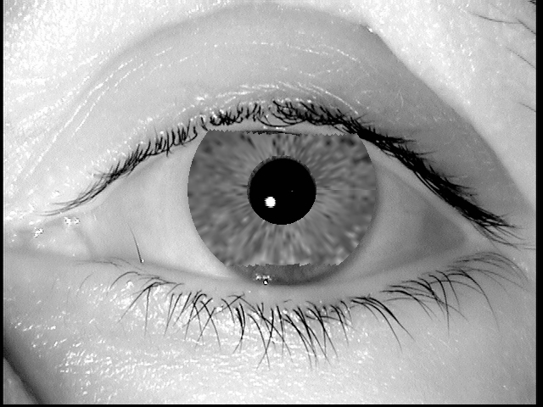
Establishing Trust Today
Password or Feature-space representation
Crypto Hashes
Stored Templates
[GalballyRoss Gomez-BarreroFierrez Ortega-Garcia2012]
Sensing
Feature
Extraction
Matching
Authentication Framework
Resource
Primary Characteristic
Representation
Exact?
Within a Range?
Stored Key
Data
Sensors
Password, PIN, …;
Fingerprint, Iris, …;
Serial #, Binary, Electrical, Optical Properties
Invariances
Noise Reduce
Crypto Hash
User Identity
User Role
Services
Points of vulnerability: Reverse engineer user information
Notes:
In a traditional model, keys are resident on some device and we use sensing to gain access to the keys. We will be considering measurement of some physical property, this is sensed and transformed by some type of feature extraction into a canonical representation. For passwords, this is traditionally just a hash, while transforms for physical devices and biometrics are typically more involved. This representation is then compared to a stored template and an access decision is made based on this comparison. At this point the key is unlock and used to authenticate the user to a framework that makes a decision whether they are allowed to use a particular resource. There are a couple of problems with this approach but I would like to focus on one. If this device is lost or stolen then all the necessary credentials are being stored at rest. Even if the access keys can be moved to a remote server. The stored template is still a problem. In particular, last month researchers from Spain showed how to take a stored template and produce an accepting iris image.

Slide 63
Establishing Trust
Stored Templates
No stored keys/templates
Derive keys directly from features
Use keys as a starting point for access control
Password or Feature-space representation
Crypto Hashes
Sensing
Feature
Extraction
Matching
Authentication Framework
Resource
Physical Phenomenon Unique to Individual
Extract Features while retaining Entropy
Use Entropy to produce key material
Stored Key
Data
Resource decisions based on knowledge of proper keys
Sensors
Services
Goal: Create cryptographic trust directly from identification data
Notes:
We’ll describe a solution where the cryptographic keys are directly derived from the sensed data. We’ll derive keys directly from features and then further derive keys to assign trust to a particular role or attribute. The important step we are removing is the stored template and matching. In order for this approach to work we must start with a strongly random source (since we will derive a key from it). This generally means a robust biometric or a physical unclonable function (PUF). Then we’ll apply a transform to reduce error rates while retaining as much entropy of the sensed feature as possible. We’ll then use a technique called fuzzy extractors to produce a stable key from this noisy distribution. Then we’ll use cryptographic access control to ensure only the intended users have access to data (and it can all be stored encrypted).
No templates

Slide 64
Cryptographic Authentication
Need source of entropy to derive starting key
Distinct between users
Low variation over time and operating conditions
Easy to collect but hard to steal
Passwords have insufficient entropy
[WeirAggarwalCollinsStern2010]
Look at alternative sources to derive keys
Notes:
Next, I’ll go through the characteristics that make a good biometric using a human iris as an example and show how to derive a stable key from a noisy distribution.

Slide 65
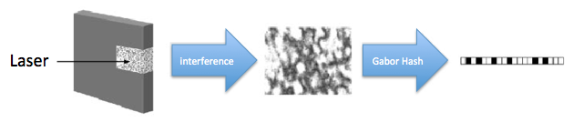
Key Derivation from Noisy Sources
Physical Unclonable Functions (PUFs)
Biometric Data
Interference
Gabor Hash
High-entropy sources with noise
Initial reading w₀ ≠ later reading w₁
Assume a bound on distance: d(w₀, w₁) ≤ t
Goal: derive a stable cryptographically strong output
Want w₀, w₁ to map to same output
The output should look uniform to the adversary
Substantial previous work on this problem: Does not secure many sources
Notes:
http://sigma.octopart.com/14152599/image/Microchip-TC14433EPG.jpg
http://www.drgaelriverz.com/images/Round_Eye.JPG

Slide 66
Error Correcting Code
Goal encode information so recoverable from t errors
Code: set C over Z^{k} c, c’ in C, d(c, c’)≥ 2t(if one exists within distance t)
c’
2t
c
c
c*
t Errors
Notes:
Main parameters: dimension of Span(G), t

Slide 67
Error Correcting Code
Goal encode information so recoverable from t errors
Code: set C over Z^{k} c, c’ in C, d(c, c’)≥ 2t
For any c* possible to find nearest c (if at most t errors)
c’
2t
c
c*
c
Decode
Notes:
Main parameters: dimension of Span(G), t

Slide 68
Hamming Metric
Source w₀ = a₁,…, a_{k} symbols a_{i} over alphabet Z
d(w₀, w₁)=# of symbols in that differ
w₀
A | B | C | A | D | B | E | F | A | A
A | G | C | A | B | B | E | F | C | B
w₁
d(w₀, w₁)=4

Slide 69
Adversary specifies V
Goal: build Sketch, Rec maximizing H(W | p), for all W in V
Sketch must create augmented fixed points based only on w₀
Build family with many possible distributions for each w₀
Sketch can’t tell W from w₀
Forced to include augmented fixed points from all distributions with w₀
Adversary knows what color be provided
Viable points set by Gen
M
w₀
Adversary’s search space
Maybe this was a bad choice of viable points?

Slide 70
Adversary knows what color be provided
Alternative Points
Gen supports a family V
Build V with many colors at all w₀, colors intersect at one point
Gen receives sample w₀
Does not know what distribution it is being asked to correct
Gen selects viable w*
Number of viable points is limited
Adversary can search among viable points of a given color
w₀

Slide 71
Adversary knows what color be provided
Alternative Points
Gen supports a family V
Build V with many colors at all w₀, colors intersect at one point
Gen receives sample w₀
Does not know what distribution it is being asked to correct
Gen selects viable w*
Number of viable points is limited
Adversary can search among viable points of a given color
M
w₀
Adversary’s search space
Gen must choose viable points without knowing the color, Few viable points of each color

